Slide 1
Microsoft Cloud Adoption Advisory Board
Special November 2016 Webinar
Microsoft

Slide 2

Welcome CAAB Members
Thanks so much for your time today!
Privileges of CAAB membership
  Provide feedback on new cloud adoption content and draft content in progress
Key questions for your input
  What do you think of our current cloud adoption content?
  Are we working on the right content?
  What other content should we look at?
Joe Davies
Sr Content Developer

Slide 3
Design and build an LOB application in Azure IaaS
Joe Davies
Senior Content Developer

Slide 4
Agenda
Definitions and assumptions
Design process
Design example
Build with Azure PowerShell

Slide 5
Definitions and assumptions

Slide 6
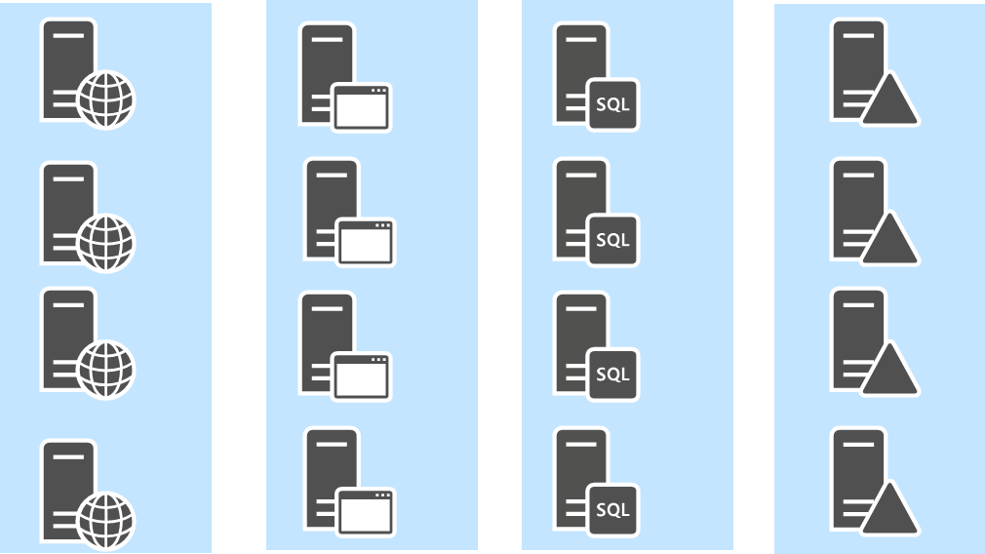
Definitions
LOB application
  A set of servers that performs some sort of meaningful IT function
  Can be intranet-only, Internet-facing only, or both
Attributes of typical LOB applications
  High availability
  High capacity
  Deployed in tiers (web front end, app/logic, database,
  identity)

Slide 7
Assumptions
Azure Resource Manager (ARM) deployment model
  No mention of classic deployment model elements or features
    Endpoints and ACLs
    Cloud services
    Azure classic portal
  Using "Location" instead of “region” or “datacenter”
Azure infrastructure configuration methods
  Azure PowerShell 1.0 and later
  Azure Command Line Interface (CLI)
  Azure portal
  ARM templates

Slide 8
Approach
Practical
  Step-by-step design methodology for the Azure infrastructure services environment
  Distill down the design decisions to the settings required for configuring each element
    Resource groups, virtual networks, subnets, storage accounts, network security groups, virtual machines, etc.
  Use the determined settings and PowerShell/CLI command blocks or ARM templates to build out the networking environment and virtual machines
Foundation assumed
  You understand the environment of Azure virtual machines (network, compute, storage, management)
  You understand Azure infrastructure elements, their hierarchy, dependencies, and boundaries
  You have determined naming conventions for Azure resources (see Appendix: Design your naming conventions in this deck)

Slide 9
Q&A

Slide 10
Design process

Slide 11
Goals of the design process
Identify the Azure infrastructure for the VMs:
  Location in a subscription
  Resource groups
  VNets and subnets
  Network security groups
  Storage accounts
  Availability sets
  Load balancers
Identify the set of VMs for the LOB application and their settings:
  Image
  Size
  Extra disks
  NICs and addressing (private/public)

Slide 12
Major design steps
Resource groups
Connectivity
Storage
Identity
Security
Virtual machines

Slide 13

Step 1: Design your resource groups
Resource groups are management containers for Azure infrastructure elements
  Manage an element set as a group
  Tagging
  RBAC for secure access with granular permissions
Recommendation
  Use multiple resource groups
    Infrastructure and applications
    Tiers/roles/IT departments

Slide 14




Single resource group
LOB App
Gateway
Management
Jumpbox
Monitoring

Slide 15
Multiple resource groups: Infra and App
App
Gateway
Management
Jumpbox
Monitoring
Infrastructure

Slide 16
Multiple resource groups: Per tier and infra
WEB
APP
DB
ID
Gateway
MGMT
Management
Jumpbox
Monitoring
Infrastructure

Slide 17
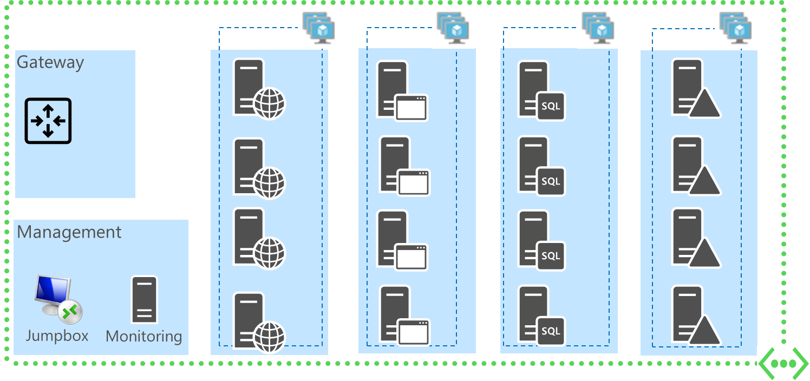
Multiple resource groups for multiple workloads
WEB
APP
DB
ID
INFRA
MGMT

Slide 18
Results of Step 1
List of resource groups and their intended elements
  Infrastructure and app
  Infrastructure and tier/department/role boundaries

Slide 19
Step 2: Design your connectivity
LOB app in multiple regions
  Multiple VNets
VNet types
  Cloud-only or cross-premises (extension of your on-premises network)
VNet connections
  Point-to-site VPN for cloud-only VNets
  Site-to-site VPN or ExpressRoute for cross-premises VNets
  VNet-to-VNet or VNet peering for either VNet type
Name registration and resolution
  DNS server IP addresses are assigned to the VMs in a VNet
  Can be Azure DNS servers, DNS servers in the VNet, or on-premises DNS servers

Slide 20
Step 2: Design your connectivity (cont.)
Addressing
  Address space for the VNet and each subnet
Routing
  Routing to and from the Internet
  Cross-premises VNets
  Routing from the intranet with a VNet address space route
  Routing to the intranet with the Local Network address space
  Overriding default subnet routing with user-defined routing

Slide 21
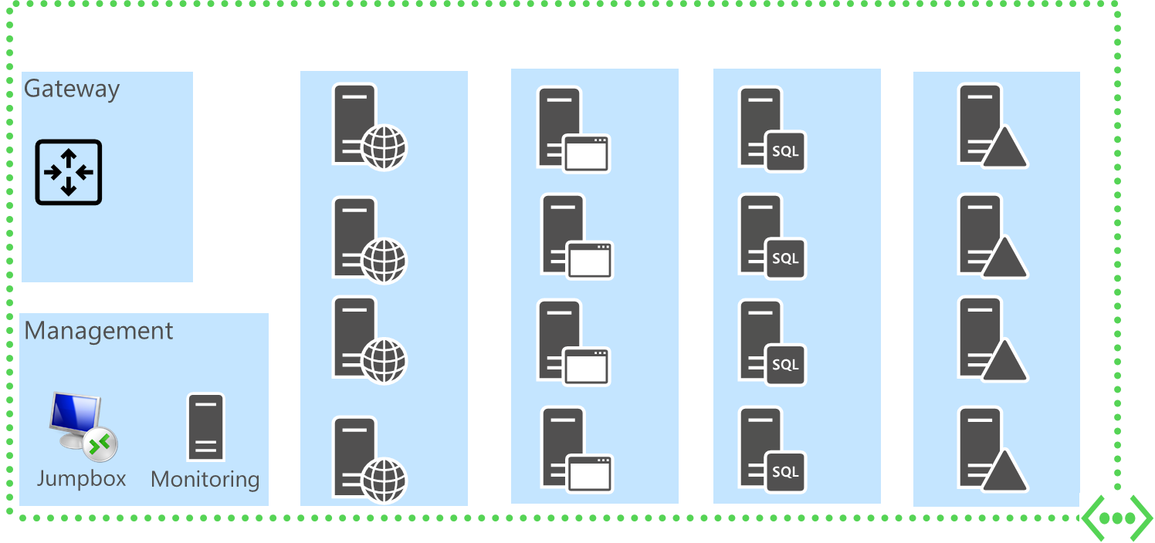
Subnets in an Azure VNet
VM-hosting
  Hosts Azure virtual machines
Gateway
  Hosts the two VMs of your Azure gateway and other VMs for ExpressRoute
  Only used for VNets that are connected to an on-premises (S2S VPN or ExpressRoute) or to another VNet
  Azure Patterns and Practices (P&P) recommendation: /27
Management
  Hosts a jumpbox VM and a monitoring VM
  Initiate remote desktop connections to all the VMs in the VNet instead of assigning a public IP address to each VM
  Computer monitoring software

Slide 22
Connectivity best practices for LOB apps
Use a VNet address space large enough for current and future capacity
  Enough address space for all of the VMs on all of your subnets (gateway, management, VM-hosting)
Use a separate subnet for each tier or role
  A subnet-specific network security group can provide subnet isolation
  For n host bits on an Azure subnet, there are 2^{n}-5 possible host addresses

Slide 23
Connectivity best practices for LOB apps (cont.)
Define your gateway subnet using the last part of the VNet address space
  For the variable bits in the VNet address space, set the bits used for the gateway subnet to 0 and the remaining bits to 1
  Example:
VNet address space of 10.19.0.0/16 is:
Gateway subnet prefix length is /28 (last 4 bits):
VNet address space with reserved bits for the gateway subnet:
Set the V bits to 1 and the G bits to 0:
Convert to decimal and include the gateway subnet prefix length:
10.19.00000000.00000000
10.19.--------.----0000
10.19.VVVVVVVV.VVVVGGGG
10.19.11111111.11110000
10.119.255.240/28

Slide 24
VNet and subnet address space example
Intranet web-based LOB app
Assumption: Maximize use of
your private address space
  Minimize wasting of private address space
Question: What is the minimum size VNet address space to host this LOB app?

Slide 25
VNet and subnet address space example (cont.)
How many subnets?
  Gateway subnet + Management subnet + 4 subnets for the four tiers of the app = 6 subnets total (3 subnet bits)
How big do the subnets need to be?
  /29 (3 bits) for the management subnet (2 VMs)
  /28 (4 bits) for the tier subnets (4 VMs)
  /27 (5 bits) for the Gateway subnet (recommended)
The number of bits needed is 8
  3 bits to accommodate 6 subnets + 5 bits to accommodate the Gateway subnet
The VNet must be at least a /24
Number of subnets needed | Number of subnet bits
1-2 | 1
3-4 | 2
5-8 | 3
9-16 | 4
Number of host addresses needed | Number of host bits for an Azure subnet
1-3 | 3 (/29)
4-11 | 4 (/28)
12-27 | 5 (/27)
28-59 | 6 (/26)

Slide 26



Resources for connectivity design
Microsoft Cloud Networking for Enterprise Architects
Implementing a Hybrid Network Architecture with Azure and On-premises VPN
Implementing a Hybrid Network Architecture with Azure ExpressRoute

Slide 27
Results of Step 2
The set of VNets needed to host the LOB app
For each VNet:
  Type
  Connections (point-to-site, site-to-site VPN, ExpressRoute, VNet-to-VNet, VNet peering)
  Address space (single address prefix or CIDR block)
  Subnets (gateway, management, and VM-hosting for each tier of the LOB app) and their address spaces
  DNS configuration (IP addresses of DNS servers)
  Cross-premises VNets
    Gateways
    Local gateway devices
    Intranet routes for the VNet address space
    Local Network address spaces for routing
  User-defined routes

Slide 28

Step 3: Design your storage
Storage types: Standard vs. Premium
  Exchange Server 2016 VMs and SharePoint VMs running the Search Index role in production require premium storage
  Azure P&P recommendation: ALL production workloads should use premium storage
Data replication
  Use locally redundant storage (LRS) for VMs
Extra disks for VMs
Disk caching
  Default is Read/Only for data disks and Read/Write for OS disks
Storage accounts

Slide 29
Storage account constraints
Standard storage
  Maximum of 40 active disks per storage account
Premium storage
  Maximum of 35 TB of provisioned space per storage account
For both standard and premium storage
  Maximum storage accounts per subscription: 100 (default) or 250 with support ticket
P&P recommendation: One storage account per VM
  May not scale to the largest deployments

Slide 30
Results of Step 3
The set of storage accounts for
  VMs and their disks
  One storage account for VM diagnostics
For each storage account:
  Location
  Resource group
  Name (DNS globally unique)
  Locally redundant storage (LRS)
  Type (standard or premium)
  The VM(s) whose disks it will contain

Slide 31
Step 4: Design your identity tier
Authentication provider and methods
  Windows Server Active Directory (AD) or other
  Client authentication
  Server-to-server authentication
  Integrated with Azure AD instance for the subscription
  Integration/replication with an on-premises identity provider (cross-premises VNets)
High availability for authentication requests
Authentication request traffic distribution
  DNS round robin
  Azure load balancer
  Network appliance in Azure
Resource: Azure identity management

Slide 32
Results of Step 4
The set of VMs to support identity/authentication for the LOB application
  P&P recommendation: At least 3 VMs in its own tier
  Synchronized/replicated with on-premises identity provider for cross-premises VNets
The load distribution method
Rules in network security groups to allow authentication/authorization network traffic

Slide 33
Step 5: Design for security
Minimizing exposure to the Internet
  Don't assign VMs a public IP address unless needed
  Use a jumpbox VM for remote desktop connections
  Use a network appliance to scan incoming traffic
Inbound and outbound traffic flows
  Stateful, host-based firewalls
  Network security groups
  End-to-end encryption with IPsec policies
Traffic flow inspection
  Azure network appliance
Disk encryption
Anti-malware
  Agents running on virtual machines
Resource:
Virtual Machines-Security

Slide 34
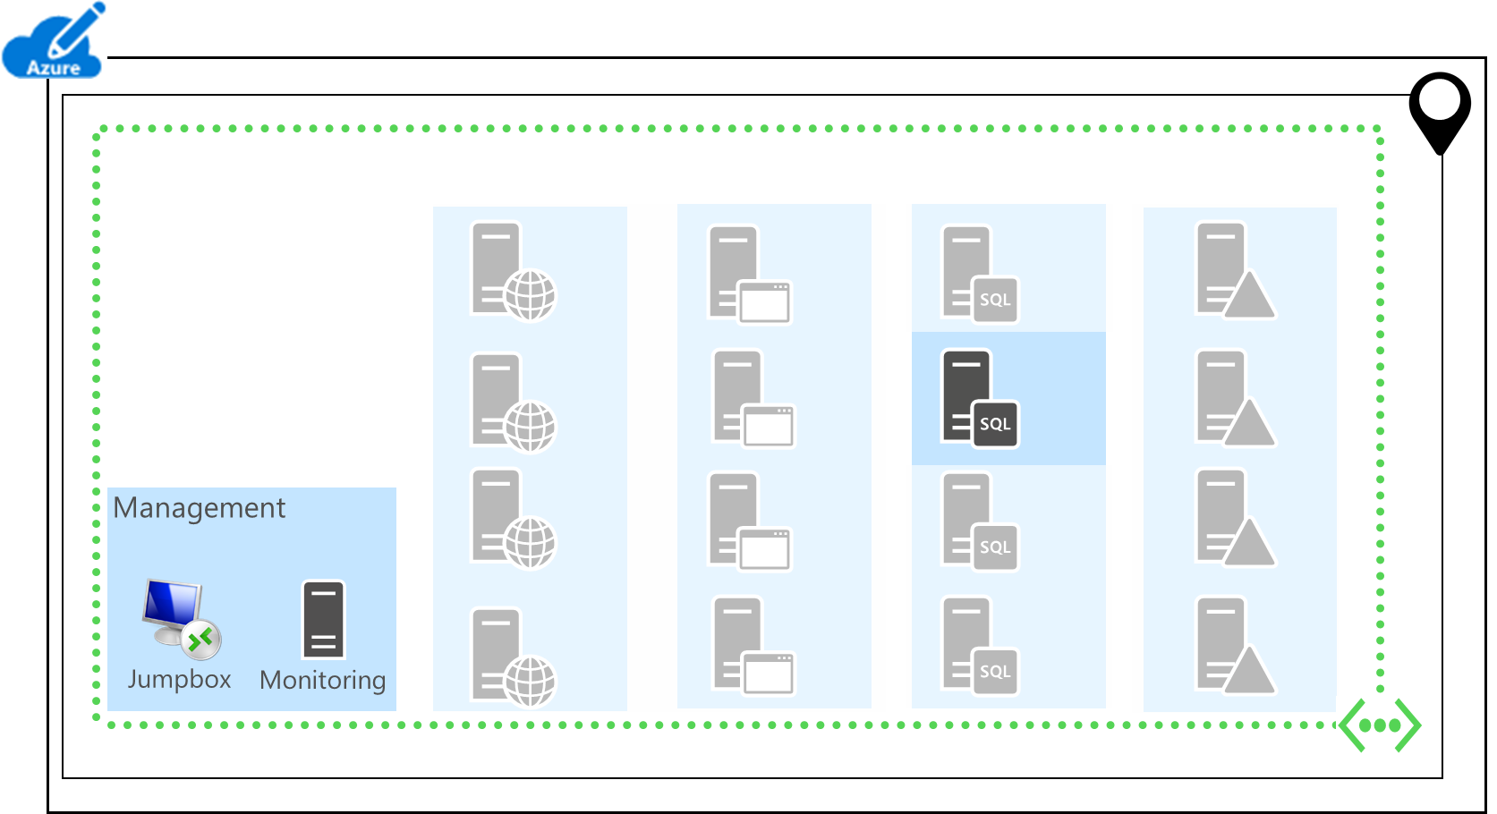
Using a jumpbox VM
Only VM with a public IP address
  Management subnet NSG allows inbound TCP 3389 from a whitelist or all IP addresses
  Subnet-specific NSGs allow inbound TCP 3389 from static, private IP address of the jumpbox VM
Step 1
  Remote desktop connection to
  the jumpbox VM
Step 2
  Create new (nested) remote desktop
  connection from the jumpbox VM
  to the desired VM
  Use RD Session Host on the
  jumpbox for more than 2
  simultaneous RD connections

Slide 35
Results of Step 5
Jumpbox with public IP address
Network security groups for subnet isolation
  Rules for allowed inbound and outbound addresses and ports (application, authentication, management traffic)
The use of network appliances
  Enhanced firewalling
  Traffic inspection, intrusion detection, etc.
IPsec policies for end-to-end encryption
Azure Key Vault for encryption keys
Anti-malware agents for VMs

Slide 36
Step 6: Design your VMs
Tiers of your LOB app
Sizes and series
  DS or GS series if using premium storage
High availability with multiple VMs at each tier and availability sets
  P&P recommendation: At least 3 VMs per tier

Slide 37
Step 6: Design your VMs (cont.)
Distribute incoming traffic to multiple VMs in a tier
  DNS round robin
  Azure load balancer instance (Internet-facing or internal) and inbound NAT rules
  Azure network appliance
Addresses for each VM
  Private addresses assigned from the subnet address space
  Public addresses and associated DNS names
Resource: Running VMs for an N-tier architecture

Slide 38
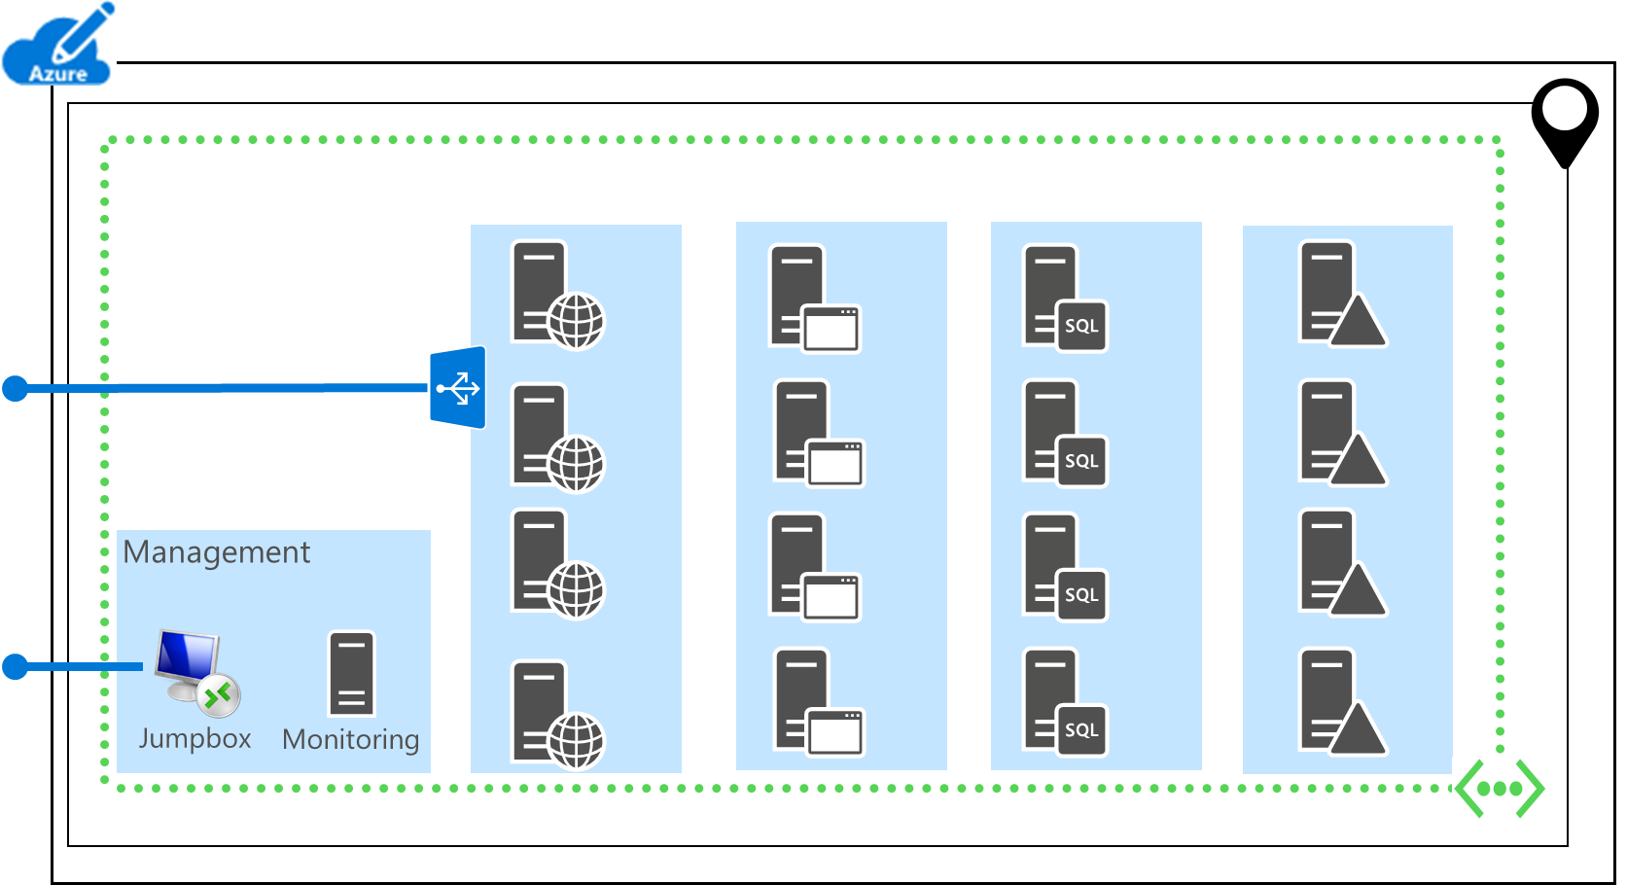
Addressing for VMs
Default: One private IPv4 address for each NIC
You can also assign:
  Multiple NICs to a VM connected to different subnets (maximum depends on the VM family/size)
  Static private IPv4 addresses
Recommendations for
public IPv4 addresses
  For typical Internet-facing LOB apps, assign only to
  Internet-facing load balancers and the jumpbox VM

Slide 39
Results of Step 6
The set of VMs in their tiers
The set of Azure settings for each tier
  Resource group
  Subnet of a VNet
  Availability set
  Load balancer
The set of Azure settings and elements for each VM
  Environment settings
  VM-specific settings

Slide 40
For each VM
Azure environment settings
  Location
  Resource group
  Storage account
  VNet/Subnet
  Member of an availability set
  Member of a load balancer instance
VM-specific settings
  Name
  Image (Publisher, Offer, Sku)
  Size (VM series)
  Extra disks w/host caching setting
  Addresses (static private addresses, public addresses)

Slide 41
RECAP: Results of the overall LOB application design process for Azure IaaS
The set of Azure elements for the LOB application and their settings
  Subscription
  Locations
  Resource groups
  Storage accounts
  Virtual networks
  Subnets
  Network security groups
  Availability sets
  Load balancers
  Virtual machines

Slide 42
Q&A

Slide 43
Design example

Slide 44
Example LOB app for financial analysis
Wingtip Financial Services is offering its customers a self-contained financial analysis engine
  Based on IIS and SQL Server 2014 AlwaysOn Availability Groups
  Proprietary algorithms to perform futures trading analysis
  Four tiers:
Web
Logic
Data
ID
Cluster

Slide 45
Step 1: Resource groups
WEB
APP
DATA
AD
Cluster
MGMT
INFRA

Slide 46
Results of design Step 1: Resource groups
Separate resource groups for the infrastructure (CUST1-INFRA), the tiers, and the management VMs
VM name | Location | Resource group
JB | East US 2 | CUST1-MGMT
MON | East US 2 | CUST1-MGMT
DC1 | East US 2 | CUST1-AD
DC2 | East US 2 | CUST1-AD
SQL1 | East US 2 | CUST1-DATA
SQL2 | East US 2 | CUST1-DATA
MN1 | East US 2 | CUST1-DATA
APP1 | East US 2 | CUST1-APP
APP2 | East US 2 | CUST1-APP
WEB1 | East US 2 | CUST1-WEB
WEB2 | East US 2 | CUST1-WEB

Slide 47
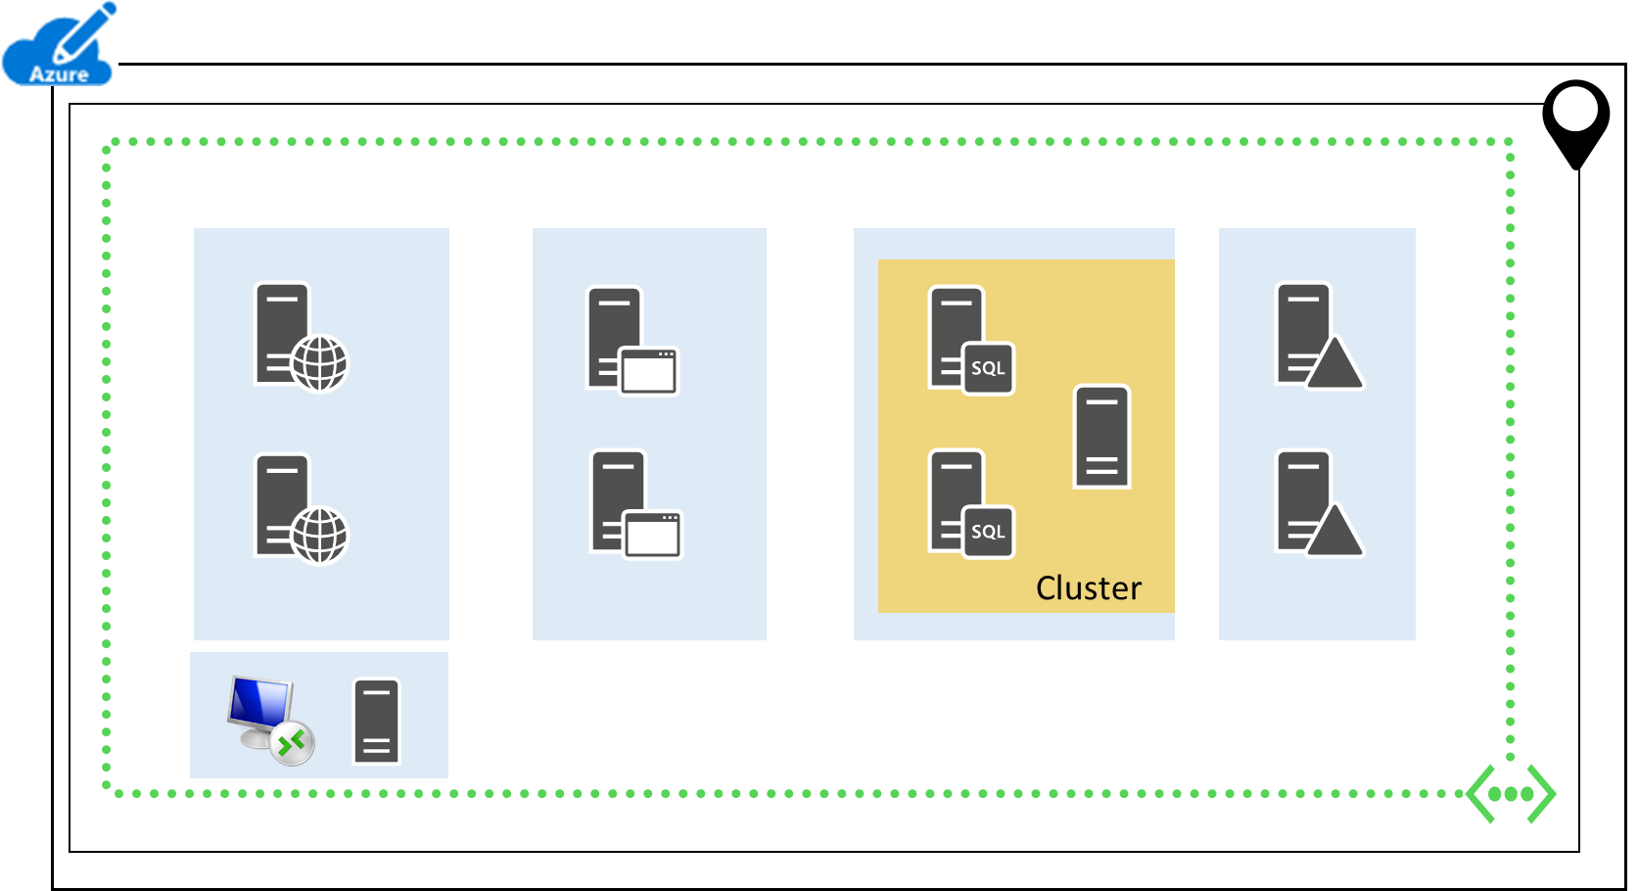
Results of design Step 2: Connectivity
One VNet needed to host the LOB app for a customer
  Type: cloud-only
  Address space: 10.0.0.0/16
  Subnets: Management and one for each tier, using 10.0.1.0/24 (AD), 10.0.2.0/24 (DATA), 10.0.3.0/24 (APP), 10.0.4.0/24 (WEB), and 10.0.5.0/24 (MGMT)
  DNS configuration: The Windows Server AD
  DCs are also DNS servers, forwarding to
  Internet root servers

Slide 48
Results of design Step 2: Connectivity
Example for an East Coast-based customer of Wingtip Financial Services
VM name | Virtual network | Subnet
JB | WFE-CUST1 | MGMT
MON | WFE-CUST1 | MGMT
DC1 | WFE-CUST1 | IDENT
DC2 | WFE-CUST1 | IDENT
SQL1 | WFE-CUST1 | DATA
SQL2 | WFE-CUST1 | DATA
MN1 | WFE-CUST1 | DATA
APP1 | WFE-CUST1 | APP
APP2 | WFE-CUST1 | APP
WEB1 | WFE-CUST1 | WEB
WEB2 | WFE-CUST1 | WEB

Slide 49
Step 3: Disks/space needed for each VM
Standard storage
2
3
5 TB
2
1
2
3
5 TB
2
Cluster
1
1
Premium storage

Slide 50
Results of Step 3: Storage
12 storage accounts
  10 standard
    9 for VMs
    1 for diagnostics (STD0)
  2 premium
    2 for SQL Server VMs
  NOTE: Using one storage account per VM, Wingtip Financial Services, can support 20 customers per subscription [int(250/12)]
VM name | Disks/space | Storage account
JB | 1 | STD1
MON | 1 | STD2
DC1 | 2 | STD3
DC2 | 2 | STD4
SQL1 | 5 TB | PREM1
SQL2 | 5 TB | PREM2
MN1 | 1 | STD5
APP1 | 3 | STD6
APP2 | 3 | STD7
WEB1 | 2 | STD8
WEB2 | 2 | STD9

Slide 51
Results of Step 4: Identity
The set of VMs to support identity for the LOB application
  SQL Server 2014 Enterprise requires Windows Server AD membership
  DC1 and DC2 in a private forest
The load distribution method
  DNS round robin to DC1 and DC2
The set of network security groups and settings to allow authentication/authorization request traffic
  Example: NSG for the IDENT subnet allows inbound Windows Server AD traffic allowed from the WEB, APP, and DATA subnets

Slide 52
Results of Step 5: Security
Jumpbox with a public IP address
Network security groups for subnet isolation
Azure Key Vault for encryption keys
  For decrypting proprietary algorithm code
Anti-malware agents for VMs

Slide 53
Step 6: VMs, availability sets, and load balancers
Cluster

Slide 54
Results of Step 6
VM name | Size | Image | Static private IP? | Public IP? | Availability set | Load balancer instance
JB | D2 | WS 2012 R2 | Yes | Yes | - | -
MON | D2 | WS 2012 R2 | Yes | No | - | -
DC1 | D2 | WS 2012 R2 | Yes | No | DCs | -
DC2 | D2 | WS 2012 R2 | Yes | No | DCs | -
SQL1 | DS4 | SQL 2014 Ent | Yes | No | SQLs | DATA-ILB
SQL2 | DS4 | SQL 2014 Ent | Yes | No | SQLs | DATA-ILB
MN1 | D2 | WS 2012 R2 | Yes | No | SQLs
APP1 | D4 | WS 2012 R2 | No | No | APPs | APP-ILB
APP2 | D4 | WS 2012 R2 | No | No | APPs | APP-ILB
WEB1 | D2 | WS 2012 R2 | No | No | WEBs | WEB-ELB
WEB2 | D2 | WS 2012 R2 | No | No | WEBs | WEB-ELB

Slide 55
Example design recap
Azure environment:
  1 Azure subscription in one location
  6 resource groups
  1 cloud-only VNet
  5 subnets (management plus 4 tiers)
  5 network security groups (one for each subnet)
  12 storage accounts (10 standard and 2 premium)
  4 availability sets (one for each tier)
  3 load balancer instances (1 Internet-facing and 2 internal)
11 VMs:
  2 management VMs
  9 VMs for the app: 2 for the ID tier, 3 for the Data tier, 2 for the App, and 2 for the Web tier

Slide 56
Azure environment settings for each VM
VM name | Location | Resource group | Storage account | Availability set | Virtual network | Subnet | Load balancer instance
JB | East US 2 | CUST1-MGMT | STD1 | - | WFE-CUST1 | MGMT | -
MON | East US 2 | CUST1-MGMT | STD2 | - | WFE-CUST1 | MGMT | -
DC1 | East US 2 | CUST1-AD | STD3 | DCs | WFE-CUST1 | IDENT | -
DC2 | East US 2 | CUST1-AD | STD4 | DCs | WFE-CUST1 | IDENT | -
SQL1 | East US 2 | CUST1-DATA | PREM1 | SQLs | WFE-CUST1 | DATA | DATA-ILB
SQL2 | East US 2 | CUST1-DATA | PREM2 | SQLs | WFE-CUST1 | DATA | DATA-ILB
MN1 | East US 2 | CUST1-DATA | STD5 | SQLs | WFE-CUST1 | DATA | -
APP1 | East US 2 | CUST1-APP | STD6 | APPs | WFE-CUST1 | APP | APP-ILB
APP2 | East US 2 | CUST1-APP | STD7 | APPs | WFE-CUST1 | APP | APP-ILB
WEB1 | East US 2 | CUST1-WEB | STD8 | WEBs | WFE-CUST1 | WEB | WEB-ELB
WEB2 | East US 2 | CUST1-WEB | STD9 | WEBs | WFE-CUST1 | WEB | WEB-ELB

Slide 57
VM-specific settings for each VM
VM name | Size | Image | Disks/Space | Static private IP? | Public IP?
JB | D2 | WS 2012 R2 | 1 | Yes | Yes
MON | D2 | WS 2012 R2 | 1 | Yes | No
DC1 | D2 | WS 2012 R2 | 2 | Yes | No
DC2 | D2 | WS 2012 R2 | 2 | Yes | No
SQL1 | DS4 | SQL 2014 Ent | 5 TB | Yes | No
SQL2 | DS4 | SQL 2014 Ent | 5 TB | Yes | No
MN1 | D2 | WS 2012 R2 | 1 | Yes | No
APP1 | D4 | WS 2012 R2 | 3 | No | No
APP2 | D4 | WS 2012 R2 | 3 | No | No
WEB1 | D2 | WS 2012 R2 | 2 | No | No
WEB2 | D2 | WS 2012 R2 | 2 | No | No

Slide 58
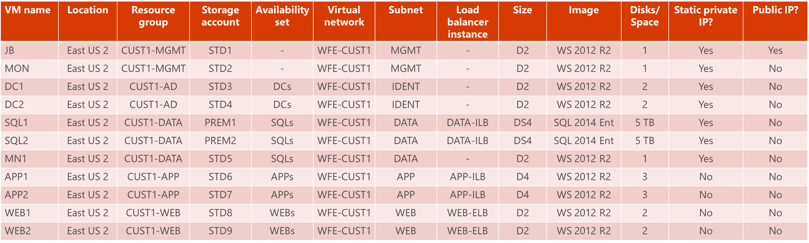
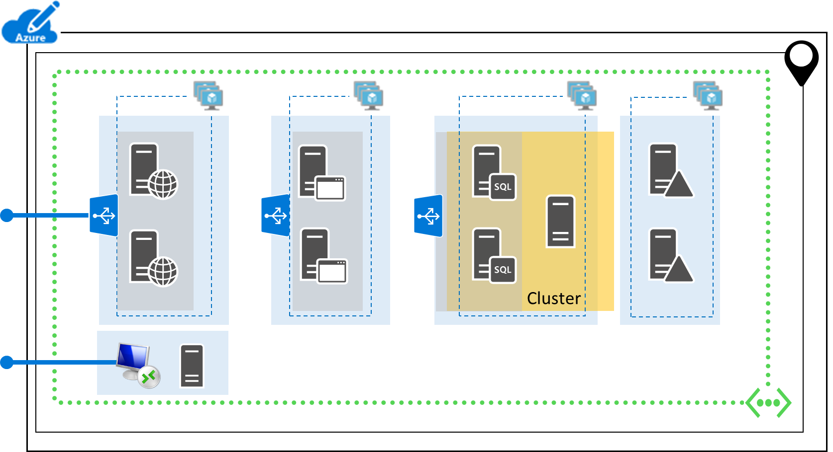
The complete table for the LOB application

Slide 59
Q&A

Slide 60
Build with Azure PowerShell

Slide 61
Why Azure PowerShell?
Easiest for single build-out, customized, production deployments
  Reuse command blocks to create standard elements of Azure infrastructure
  Use variables to control the settings of VMs in tiers (resource groups, storage accounts, etc.)
Many IT implementers are already comfortable with PowerShell
  Integrated Script Environment (ISE)
  Command blocks are easily scriptable/functionable
Azure CLI is an alternative for Apple/Linux users

Slide 62
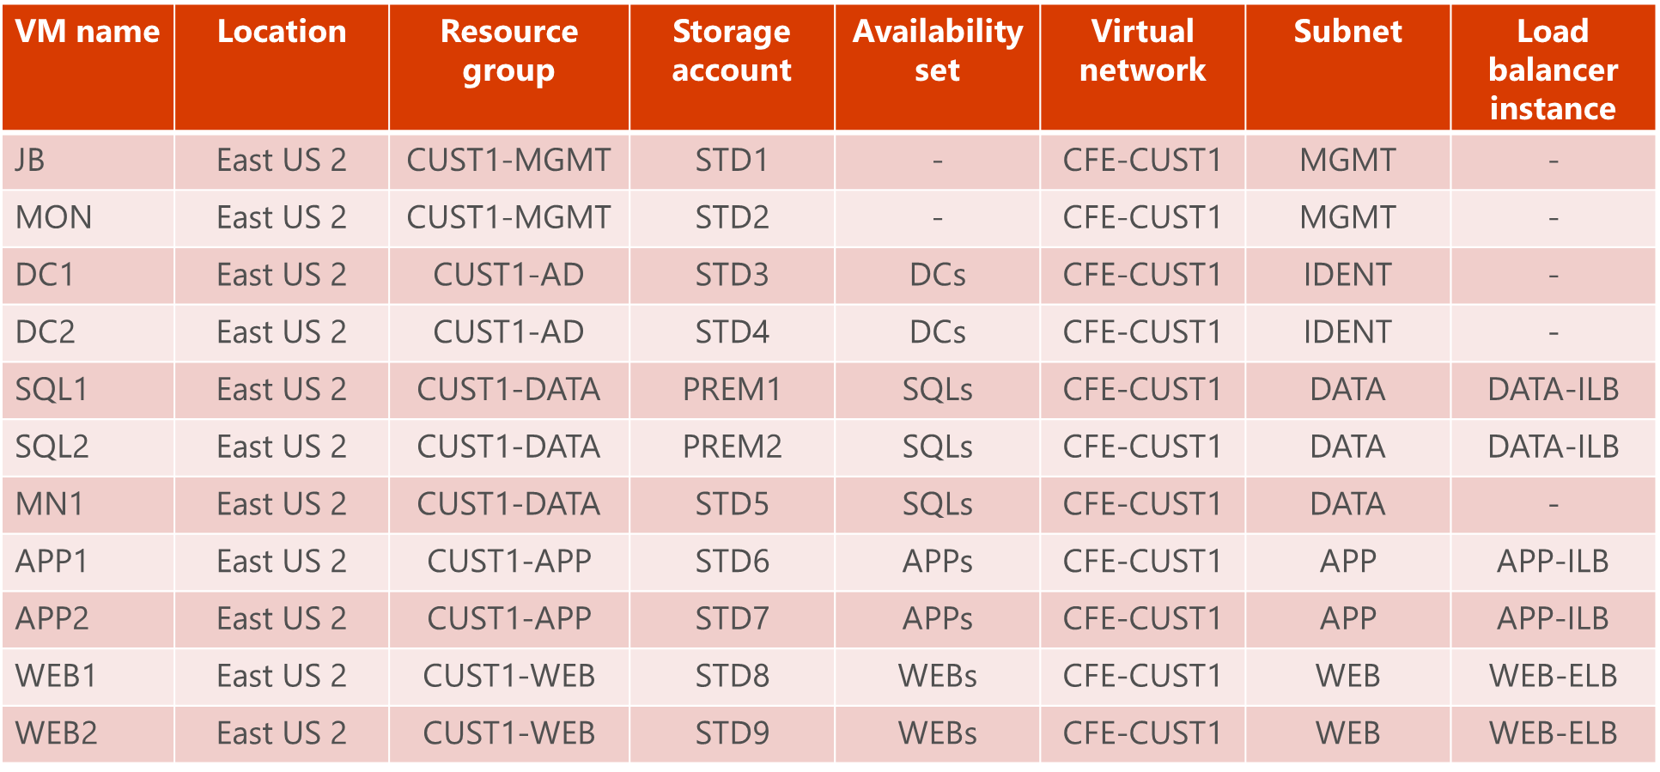
High-level steps to deploy the LOB application
1. Build out the Azure environment
  Resource groups
  Storage accounts
  Availability sets
  VNets with subnets
    VNet gateways and connections
    Network security groups
  Load balancer instances
See the Appendix: PowerShell Command Blocks section of this slide deck for examples.

Slide 63
Example of using PowerShell command blocks
$locName="<an Azure location, such as West US>"
$rgName="<resource group name>"
New-AzureRMResourceGroup -Name $rgName -Location $locName
$locName="East US 2"
$rgName="CUST1-MGMT"
New-AzureRMResourceGroup -Name $rgName -Location $locName
$rgName="CUST1-AD"
New-AzureRMResourceGroup -Name $rgName -Location $locName
$rgName="CUST1-DATA"
New-AzureRMResourceGroup -Name $rgName -Location $locName
$rgName="CUST1-APP"
New-AzureRMResourceGroup -Name $rgName -Location $locName
$rgName="CUST1-WEB"
New-AzureRMResourceGroup -Name $rgName -Location $locName
$rgName="CUST1-INFRA"
New-AzureRMResourceGroup -Name $rgName -Location $locName

Slide 64
Example of using PowerShell command blocks
$locName="East US 2"
$rgName="CUST1-INFRA"
$vnetName="WFE-CUST1"
$vnetAddrPrefix="10.0.0.0/16"
$dnsServers=@( "10.0.1.4", "10.0.1.5" )
$subnetName="MGMT"
$subnetPrefix="10.0.5.0/24"
$subnet1=New-AzureRMVirtualNetworkSubnetConfig -Name $subnetName -AddressPrefix $subnetPrefix
$subnetName="IDENT"
$subnetPrefix="10.0.1.0/24"
$subnet2=New-AzureRMVirtualNetworkSubnetConfig -Name $subnetName -AddressPrefix $subnetPrefix
$subnetName="DATA"
$subnetPrefix="10.0.2.0/24"
$subnet3=New-AzureRMVirtualNetworkSubnetConfig -Name $subnetName -AddressPrefix $subnetPrefix
$subnetName="APP"
$subnetPrefix="10.0.3.0/24"
$subnet4=New-AzureRMVirtualNetworkSubnetConfig -Name $subnetName -AddressPrefix $subnetPrefix
$subnetName="WEB"
$subnetPrefix="10.0.4.0/24"
$subnet5=New-AzureRMVirtualNetworkSubnetConfig -Name $subnetName -AddressPrefix $subnetPrefix
New-AzureRMVirtualNetwork -Name $vnetName -ResourceGroupName $rgName -Location $locName -AddressPrefix $vnetAddrPrefix -Subnet $subnet1,$subnet2,$subnet3,$subnet4,$subnet5 -DNSServer $dnsServers

Slide 65
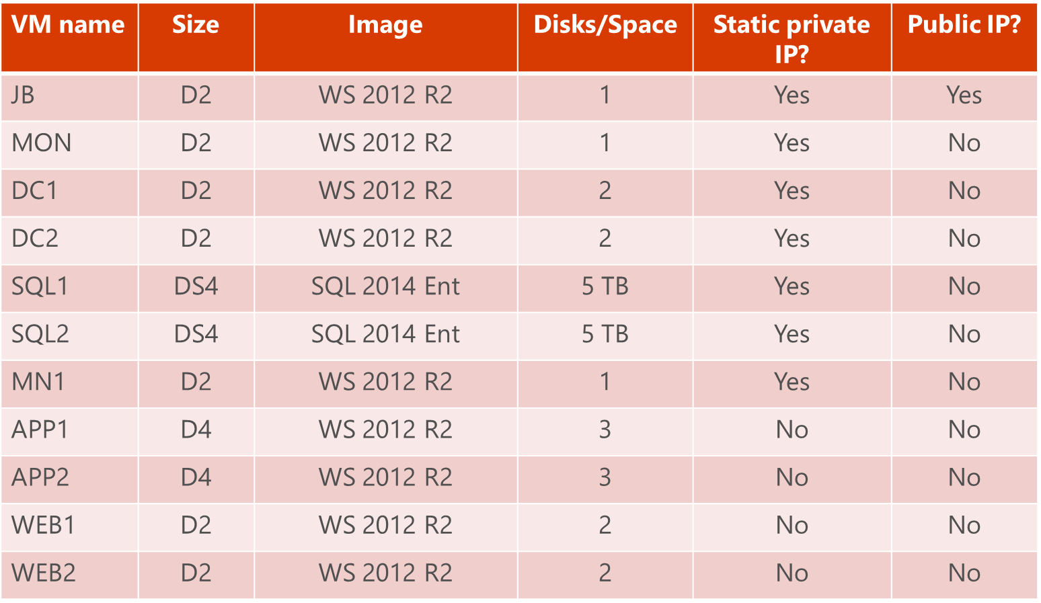
High-level steps to deploy the LOB application (cont.)
2. Build out your tiers
  Create each VM with the appropriate environment and VM-specific settings
  Switch resource groups as needed
3. Configure the LOB application
  Configure the services on each VM to provide the desired workload
See the Appendix: PowerShell Command Blocks section of this slide deck for examples of building VMs.

Slide 66
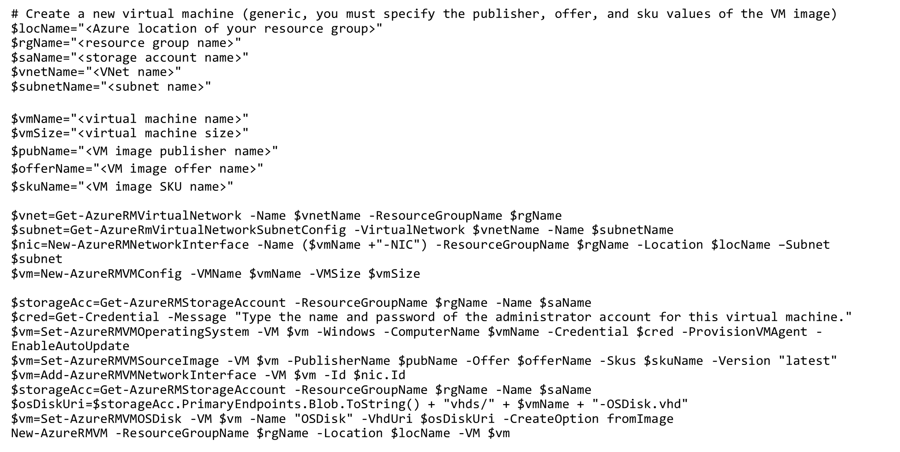
Creating a VM
Standard PowerShell command block to create a VM:

Slide 67
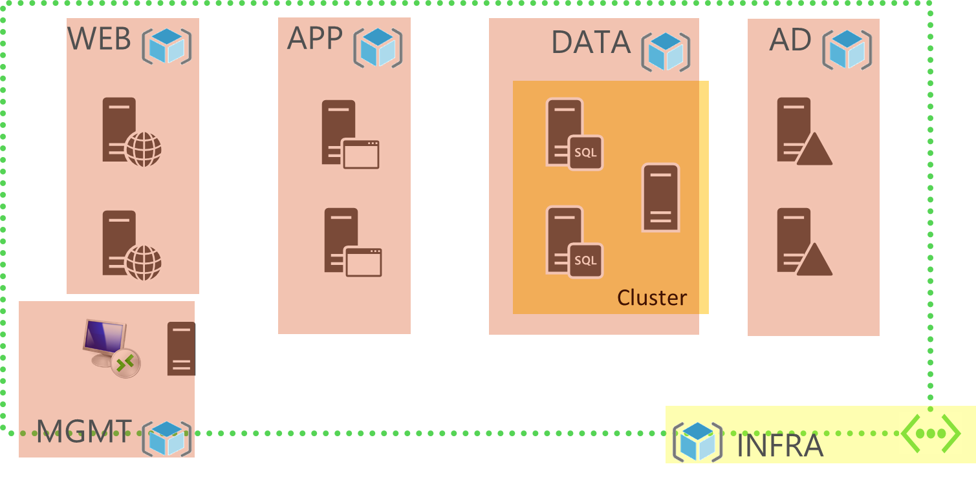
Example of resource group context switch
VNet is in the INFRA resource group
VMs are in a tier-based resource group

Slide 68
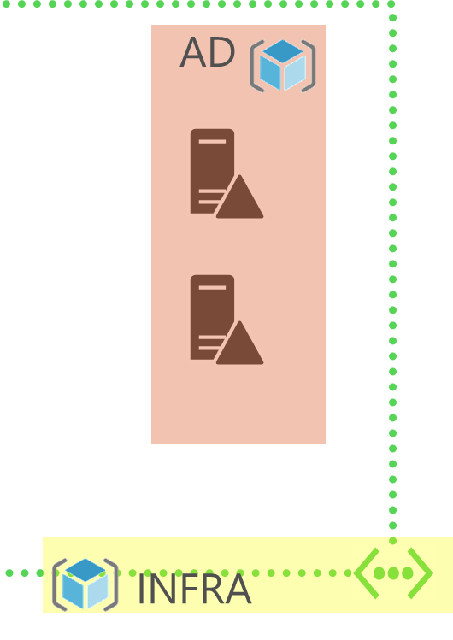
PowerShell example
# Set up environment variables
$locName="East US 2"; $avName="DCs"; $vnetName="WFE-CUST1"; $subnetName="IDENT"
$rgInfraName="CUST1-INFRA"
$rgTierName="CUST1-AD"
# Set up VM-specific variables for the first DC
$vmName="DC1"
$vmSize="Standard_D2"
$staticIP="10.0.1.4"
$diskSize=20
# Get information on the VNet and subnet
$rgName=$rgInfraName
$vnet=Get-AzureRMVirtualNetwork -Name $vnetName -ResourceGroupName $rgName
$subnet=Get-AzureRMVirtualNetworkSubnetConfig -VirtualNetwork $vnet -Name $subnetName
# Create network interface and start VM creation
$rgName=$rgTierName
$nic=New-AzureRMNetworkInterface -Name ($vmName +"-NIC") -ResourceGroupName $rgName -Location $locName -Subnet $subnet -PrivateIpAddress $staticIP
$avSet=Get-AzureRMAvailabilitySet –Name $avName –ResourceGroupName $rgName
$vm=New-AzureRMVMConfig -VMName $vmName -VMSize $vmSize -AvailabilitySetId $avset.Id
...

Slide 69
Q&A

Slide 70
Appendix: PowerShell command blocks

Slide 71
Specify the Azure subscription
$subscrName="<subscription name>"
Get-AzureRmSubscription –SubscriptionName $subscrName | Select-AzureRmSubscription

Slide 72
Create a new resource group
$locName="<an Azure location, such as West US>"
$rgName="<resource group name>"
New-AzureRMResourceGroup -Name $rgName -Location $locName

Slide 73
Create a new storage account
# Test whether a proposed storage account name is globally unique
Get-AzureRmStorageAccountNameAvailability "<proposed name>"
# Create a new standard storage account
$locName="<an Azure location, such as West US>"
$rgName="<resource group name>"
$saName="<storage account name>"
New-AzureRMStorageAccount -Name $saName -ResourceGroupName $rgName –Type Standard_LRS -Location $locName
# Create a new premium storage account
$locName="<an Azure location, such as West US>"
$rgName="<resource group name>"
$saName="<storage account name>"
New-AzureRMStorageAccount -Name $saName -ResourceGroupName $rgName –Type Premium_LRS -Location $locName

Slide 74
Create a new availability set
$locName="<an Azure location, such as West US>"
$rgName="<resource group name>"
$avName="<availability set name>"
New-AzureRMAvailabilitySet –Name $avName –ResourceGroupName $rgName -Location $locName

Slide 75
Create a new cloud-only VNet
$locName="<an Azure location, such as West US>"
$rgName="<resource group name>"
$vnetName="<VNet name>"
$vnetAddrPrefix="<VNet address space>"
$dnsServers=@( "<DNS server 1 IP address>", "<DNS server 2 IP address>" )
$spSubnet1Name="<subnet 1 name>"
$spSubnet1Prefix="<subnet 1 address space>"
$spSubnet2Name="<subnet 2 name>"
$spSubnet2Prefix="<subnet 2 address space>"
$spSubnet1=New-AzureRMVirtualNetworkSubnetConfig -Name $spSubnet1Name -AddressPrefix $spSubnet1Prefix
$spSubnet2=New-AzureRMVirtualNetworkSubnetConfig -Name $spSubnet2Name -AddressPrefix $spSubnet2Prefix
New-AzureRMVirtualNetwork -Name $vnetName -ResourceGroupName $rgName -Location $locName -AddressPrefix $vnetAddrPrefix -Subnet $spSubnet1,$spSubnet2 -DNSServer $dnsServers

Slide 76
Create a new cross-premises VNet
$locName="<an Azure location, such as West US>"
$rgName="<resource group name>"
$vnetName="<VNet name>"
$vnetAddrPrefix="<VNet address space>"
$spSubnetName="<subnet name>"
$spSubnetPrefix="<subnet address space>"
$gwSubnetPrefix="<gateway subnet address space>"
$dnsServers=@( "<DNS server IP address>", "<DNS server IP address>" )
$gwSubnet=New-AzureRMVirtualNetworkSubnetConfig -Name "GatewaySubnet" -AddressPrefix $gwSubnetPrefix
$spSubnet=New-AzureRMVirtualNetworkSubnetConfig -Name $spSubnetName -AddressPrefix $spSubnetPrefix
New-AzureRMVirtualNetwork -Name $vnetName -ResourceGroupName $rgName -Location $locName -AddressPrefix $vnetAddrPrefix -Subnet $gwSubnet,$spSubnet -DNSServer $dnsServers

Slide 77
Create VNet gateways and a connection
$locName="<an Azure location, such as West US>"
$rgName="<resource group name>"
$vnetName="<VNet name>"
$vnet=Get-AzureRMVirtualNetwork -Name $vnetName -ResourceGroupName $rgName
# Attach a virtual network gateway to a public IP address and the gateway subnet
$publicGatewayVipName="<name>"
$vnetGatewayIpConfigName="<name>"
New-AzureRMPublicIpAddress -Name $vnetGatewayIpConfigName -ResourceGroupName $rgName -Location $locName -AllocationMethod Dynamic
$publicGatewayVip=Get-AzureRMPublicIpAddress -Name $vnetGatewayIpConfigName -ResourceGroupName $rgName
$vnetGatewayIpConfig=New-AzureRMVirtualNetworkGatewayIpConfig -Name $vnetGatewayIpConfigName -PublicIpAddressId $publicGatewayVip.Id -SubnetId $vnet.Subnets[0].Id
# Create the Azure gateway
$vnetGatewayName="<name>"
$vnetGateway=New-AzureRMVirtualNetworkGateway -Name $vnetGatewayName -ResourceGroupName $rgName -Location $locName -GatewayType Vpn -VpnType RouteBased -IpConfigurations $vnetGatewayIpConfig
# Create the gateway for the local network
$localGatewayName="<name>"
$localGatewayIP="<public IP address of Azure gateway>"
$localNetworkPrefix=@( <comma-separated, double-quote enclosed list of the local network address prefixes, example: "10.1.0.0/24", "10.2.0.0/24"> )
$localGateway=New-AzureRMLocalNetworkGateway -Name $localGatewayName -ResourceGroupName $rgName -Location $locName -GatewayIpAddress $localGatewayIP -AddressPrefix $localNetworkPrefix
# Create the Azure virtual network VPN connection
$vnetConnectionName="<name>"
$vnetConnectionKey="<IPsec preshared key>"
$vnetConnection=New-AzureRMVirtualNetworkGatewayConnection -Name $vnetConnectionName -ResourceGroupName $rgName -Location $locName -ConnectionType IPsec -SharedKey $vnetConnectionKey -VirtualNetworkGateway1 $vnetGateway -LocalNetworkGateway2 $localGateway

Slide 78
Create a new load balancer instance
# This example block assumes HTTP-based traffic to web servers. Modify as needed.
$locName="<an Azure location, such as West US>"
$rgName="<resource group name>"
$vnetName="<VNet name>“
$subnetName="<subnet name>"
$privIP="<available IP address on the subnet>"
$vnet=Get-AzureRMVirtualNetwork -Name $vnetName -ResourceGroupName $rgName
$subnet=Get-AzureRmVirtualNetworkSubnetConfig -VirtualNetwork $vnetName -Name $subnetName
$frontendIP=New-AzureRMLoadBalancerFrontendIpConfig -Name WebServers-LBFE -PrivateIPAddress $privIP -Subnet $subnet
$beAddressPool=New-AzureRMLoadBalancerBackendAddressPoolConfig -Name WebServers-LBBE
$healthProbe=New-AzureRMLoadBalancerProbeConfig -Name WebServersProbe -Protocol "TCP" -Port 80 -IntervalInSeconds 15 -ProbeCount 2
$lbrule=New-AzureRMLoadBalancerRuleConfig -Name "WebTraffic" -FrontendIpConfiguration $frontendIP -BackendAddressPool $beAddressPool -Probe $healthProbe -Protocol "TCP" -FrontendPort 80 -BackendPort 80
New-AzureRMLoadBalancer -ResourceGroupName $rgName -Name "WebServersInAzure" -Location $locName -LoadBalancingRule $lbrule -BackendAddressPool $beAddressPool -Probe $healthProbe -FrontendIpConfiguration $frontendIP

Slide 79
Create Network Security Groups
# This example creates two rules and two network security groups for two subnets
# Set up key variables
$rgName="<your resource group name>"
$locShortName="<the Azure locationin lowercase with all spaces removed. Example: westus>"
$vnetNam="<VNet name>"
$feSubnetName="<name of the front end subnet>"
$feSubnetAddrPref="<address prefix of the front end subnet>"
$beSubnetName="<name of the back end subnet>"
$beSubnetAddrPref="<address prefix of the back end subnet>"
# Rule to allow incoming RDP protocol traffic
$rule1 = New-AzureRMNetworkSecurityRuleConfig -Name "RDPTraffic" -Description "Allow RDP to all VMs on the subnet" -Access Allow -Protocol Tcp -Direction Inbound -Priority 100 -SourceAddressPrefix Internet -SourcePortRange * -DestinationAddressPrefix * -DestinationPortRange 3389
# Rule to allow incoming HTTP traffic only to the web servers on the front-end subnet
$rule2 = New-AzureRMNetworkSecurityRuleConfig -Name "WebTraffic" -Description "Allow HTTP to the Web servers" -Access Allow -Protocol Tcp -Direction Inbound -Priority 101 -SourceAddressPrefix Internet -SourcePortRange * -DestinationAddressPrefix $feSubnetAddrPref -DestinationPortRange 80
# Create a new network security group for the front end subnet with the RDP and HTTP rules
New-AzureRMNetworkSecurityGroup -Name "Front End LOB App" -ResourceGroupName $rgName -Location $locShortName -SecurityRules $rule1,$rule2
# Create a new network security group for the back end subnet with the RDP rule
New-AzureRMNetworkSecurityGroup -Name "Back End LOB App" -ResourceGroupName $rgName -Location $locShortName -SecurityRules $rule1
$vnet=Get-AzureRMVirtualNetwork -ResourceGroupName $rgName -Name $vnetName
# Apply the new network security group to the front end subnet.
$nsg=Get-AzureRMNetworkSecurityGroup -Name "Front End LOB App" -ResourceGroupName $rgName
Set-AzureRMVirtualNetworkSubnetConfig -VirtualNetwork $vnet -Name $feSubnetName -AddressPrefix $feSubnetAddrPref -NetworkSecurityGroup $nsg
# Apply the new network security group to the back end subnet.
$nsg=Get-AzureRMNetworkSecurityGroup -Name "Back End LOB App" -ResourceGroupName $rgName
Set-AzureRMVirtualNetworkSubnetConfig -VirtualNetwork $vnet -Name $beSubnetName -AddressPrefix $beSubnetAddrPref -NetworkSecurityGroup $nsg

Slide 80
Create a new VM (generic basic)
# Create a new virtual machine (generic, you must specify the publisher, offer, and sku values of the VM image)
$locName="<Azure location of your resource group>"
$rgName="<resource group name>"
$saName="<storage account name>"
$vnetName="<VNet name>"
$subnetName="<subnet name>"
$vmName="<virtual machine name>"
$vmSize="<virtual machine size>"
$pubName="<VM image publisher name>"
$offerName="<VM image offer name>"
$skuName="<VM image SKU name>"
$vnet=Get-AzureRMVirtualNetwork -Name $vnetName -ResourceGroupName $rgName
$subnet=Get-AzureRmVirtualNetworkSubnetConfig -VirtualNetwork $vnetName -Name $subnetName
$nic=New-AzureRMNetworkInterface -Name ($vmName +"-NIC") -ResourceGroupName $rgName -Location $locName –Subnet $subnet
$vm=New-AzureRMVMConfig -VMName $vmName -VMSize $vmSize
$storageAcc=Get-AzureRMStorageAccount -ResourceGroupName $rgName -Name $saName
$cred=Get-Credential -Message "Type the name and password of the administrator account for this virtual machine."
$vm=Set-AzureRMVMOperatingSystem -VM $vm -Windows -ComputerName $vmName -Credential $cred -ProvisionVMAgent -EnableAutoUpdate
$vm=Set-AzureRMVMSourceImage -VM $vm -PublisherName $pubName -Offer $offerName -Skus $skuName -Version "latest"
$vm=Add-AzureRMVMNetworkInterface -VM $vm -Id $nic.Id
$storageAcc=Get-AzureRMStorageAccount -ResourceGroupName $rgName -Name $saName
$osDiskUri=$storageAcc.PrimaryEndpoints.Blob.ToString() + "vhds/" + $vmName + "-OSDisk.vhd"
$vm=Set-AzureRMVMOSDisk -VM $vm -Name "OSDisk" -VhdUri $osDiskUri -CreateOption fromImage
New-AzureRMVM -ResourceGroupName $rgName -Location $locName -VM $vm

Slide 81
Create a new VM (Windows Server basic)
# Create a new Windows Server 2012 R2 Datacenter virtual machine
$locName="<Azure location of your resource group>"
$rgName="<resource group name>"
$saName="<storage account name>"
$vnetName="<VNet name>"
$subnetName="<subnet name>"
$vmName="<virtual machine name>"
$vmSize="<virtual machine size>"
$vnet=Get-AzureRMVirtualNetwork -Name $vnetName -ResourceGroupName $rgName
$subnet=Get-AzureRmVirtualNetworkSubnetConfig -VirtualNetwork $vnetName -Name $subnetName
$nic=New-AzureRMNetworkInterface -Name ($vmName +"-NIC") -ResourceGroupName $rgName -Location $locName –Subnet $subnet
$vm=New-AzureRMVMConfig -VMName $vmName -VMSize $vmSize
$storageAcc=Get-AzureRMStorageAccount -ResourceGroupName $rgName -Name $saName
$cred=Get-Credential -Message "Type the name and password of the local administrator account for this virtual machine."
$vm=Set-AzureRMVMOperatingSystem -VM $vm -Windows -ComputerName $vmName -Credential $cred -ProvisionVMAgent -EnableAutoUpdate
$vm=Set-AzureRMVMSourceImage -VM $vm -PublisherName MicrosoftWindowsServer -Offer WindowsServer -Skus 2012-R2-Datacenter -Version "latest"
$vm=Add-AzureRMVMNetworkInterface -VM $vm -Id $nic.Id
$storageAcc=Get-AzureRMStorageAccount -ResourceGroupName $rgName -Name $saName
$osDiskUri=$storageAcc.PrimaryEndpoints.Blob.ToString() + "vhds/" + $vmName + "-OSDisk.vhd"
$vm=Set-AzureRMVMOSDisk -VM $vm -Name "OSDisk" -VhdUri $osDiskUri -CreateOption fromImage
New-AzureRMVM -ResourceGroupName $rgName -Location $locName -VM $vm

Slide 82
Create a new VM in an availability set
# Create a new Windows Server 2012 R2 Datacenter virtual machine
$locName="<Azure location of your resource group>"
$rgName="<resource group name>"
$saName="<storage account name>"
$vnetName="<VNet name>"
$subnetName="<subnet name>"
$avName="<availability set name>"
$vmName="<virtual machine name>"
$vmSize="<virtual machine size>"
$vnet=Get-AzureRMVirtualNetwork -Name $vnetName -ResourceGroupName $rgName
$subnet=Get-AzureRmVirtualNetworkSubnetConfig -VirtualNetwork $vnetName -Name $subnetName
$nic=New-AzureRMNetworkInterface -Name ($vmName +"-NIC") -ResourceGroupName $rgName -Location $locName –Subnet $subnet
$avSet=Get-AzureRMAvailabilitySet –Name $avName –ResourceGroupName $rgName
$vm=New-AzureRMVMConfig -VMName $vmName -VMSize $vmSize -AvailabilitySetId $avset.Id
$storageAcc=Get-AzureRMStorageAccount -ResourceGroupName $rgName -Name $saName
$cred=Get-Credential -Message "Type the name and password of the local administrator account for this virtual machine."
$vm=Set-AzureRMVMOperatingSystem -VM $vm -Windows -ComputerName $vmName -Credential $cred -ProvisionVMAgent -EnableAutoUpdate
$vm=Set-AzureRMVMSourceImage -VM $vm -PublisherName MicrosoftWindowsServer -Offer WindowsServer -Skus 2012-R2-Datacenter -Version "latest"
$vm=Add-AzureRMVMNetworkInterface -VM $vm -Id $nic.Id
$storageAcc=Get-AzureRMStorageAccount -ResourceGroupName $rgName -Name $saName
$osDiskUri=$storageAcc.PrimaryEndpoints.Blob.ToString() + "vhds/" + $vmName + "-OSDisk.vhd"
$vm=Set-AzureRMVMOSDisk -VM $vm -Name "OSDisk" -VhdUri $osDiskUri -CreateOption fromImage
New-AzureRMVM -ResourceGroupName $rgName -Location $locName -VM $vm

Slide 83
Create a new VM with a static IP address
# Create a new Windows Server 2012 R2 Datacenter virtual machine with a static IP address
$locName="<Azure location of your resource group>"
$rgName="<resource group name>"
$saName="<storage account name>"
$vnetName="<VNet name>"
$subnetName="<subnet name>"
$avName="<availability set name>"
$vmName="<virtual machine name>"
$vmSize="<virtual machine size>"
$staticIP="<static IP address>"
$vnet=Get-AzureRMVirtualNetwork -Name $vnetName -ResourceGroupName $rgName
$subnet=Get-AzureRmVirtualNetworkSubnetConfig -VirtualNetwork $vnetName -Name $subnetName
$nic=New-AzureRMNetworkInterface -Name ($vmName +"-NIC") -ResourceGroupName $rgName -Location $locName –Subnet $subnet -PrivateIpAddress $staticIP
$avSet=Get-AzureRMAvailabilitySet –Name $avName –ResourceGroupName $rgName
$vm=New-AzureRMVMConfig -VMName $vmName -VMSize $vmSize -AvailabilitySetId $avset.Id
$storageAcc=Get-AzureRMStorageAccount -ResourceGroupName $rgName -Name $saName
$cred=Get-Credential -Message "Type the name and password of the local administrator account for this virtual machine."
$vm=Set-AzureRMVMOperatingSystem -VM $vm -Windows -ComputerName $vmName -Credential $cred -ProvisionVMAgent -EnableAutoUpdate
$vm=Set-AzureRMVMSourceImage -VM $vm -PublisherName MicrosoftWindowsServer -Offer WindowsServer -Skus 2012-R2-Datacenter -Version "latest"
$vm=Add-AzureRMVMNetworkInterface -VM $vm -Id $nic.Id
$storageAcc=Get-AzureRMStorageAccount -ResourceGroupName $rgName -Name $saName
$osDiskUri=$storageAcc.PrimaryEndpoints.Blob.ToString() + "vhds/" + $vmName + "-OSDisk.vhd"
$vm=Set-AzureRMVMOSDisk -VM $vm -Name "OSDisk" -VhdUri $osDiskUri -CreateOption fromImage
New-AzureRMVM -ResourceGroupName $rgName -Location $locName -VM $vm

Slide 84
Create a new VM with an extra disk
# Create a new Windows Server 2012 R2 Datacenter virtual machine with a single extra disk
$locName="<Azure location of your resource group>"
$rgName="<resource group name>"
$saName="<storage account name>"
$vnetName="<VNet name>"
$subnetName="<subnet name>"
$avName="<availability set name>"
$vmName="<virtual machine name>"
$vmSize="<virtual machine size>"
$diskSize=<size of the extra disk in GB>
$vnet=Get-AzureRMVirtualNetwork -Name $vnetName -ResourceGroupName $rgName
$subnet=Get-AzureRmVirtualNetworkSubnetConfig -VirtualNetwork $vnetName -Name $subnetName
$nic=New-AzureRMNetworkInterface -Name ($vmName +"-NIC") -ResourceGroupName $rgName -Location $locName –Subnet $subnet
$avSet=Get-AzureRMAvailabilitySet –Name $avName –ResourceGroupName $rgName
$vm=New-AzureRMVMConfig -VMName $vmName -VMSize $vmSize -AvailabilitySetId $avset.Id
$storageAcc=Get-AzureRMStorageAccount -ResourceGroupName $rgName -Name $saName
$vhdURI=$storageAcc.PrimaryEndpoints.Blob.ToString() + "vhds/" + $vmName + "-ADDSDisk.vhd"
Add-AzureRMVMDataDisk -VM $vm -Name "ADDSData" -DiskSizeInGB $diskSize -VhdUri $vhdURI -CreateOption empty
$cred=Get-Credential -Message "Type the name and password of the local administrator account for this virtual machine."
$vm=Set-AzureRMVMOperatingSystem -VM $vm -Windows -ComputerName $vmName -Credential $cred -ProvisionVMAgent -EnableAutoUpdate
$vm=Set-AzureRMVMSourceImage -VM $vm -PublisherName MicrosoftWindowsServer -Offer WindowsServer -Skus 2012-R2-Datacenter -Version "latest"
$vm=Add-AzureRMVMNetworkInterface -VM $vm -Id $nic.Id
$storageAcc=Get-AzureRMStorageAccount -ResourceGroupName $rgName -Name $saName
$osDiskUri=$storageAcc.PrimaryEndpoints.Blob.ToString() + "vhds/" + $vmName + "-OSDisk.vhd"
$vm=Set-AzureRMVMOSDisk -VM $vm -Name "OSDisk" -VhdUri $osDiskUri -CreateOption fromImage
New-AzureRMVM -ResourceGroupName $rgName -Location $locName -VM $vm

Slide 85
Create a new VM as an LB set member
# Create a new Windows Server 2012 R2 Datacenter virtual machine with membership in a load balancer set
$locName="<Azure location of your resource group>"
$rgName="<resource group name>"
$saName="<storage account name>"
$vnetName="<VNet name>"
$subnetName="<subnet name>"
$avName="<availability set name>"
$vmName="<virtual machine name>"
$vmSize="<virtual machine size>"
$lbName="<load balancer instance name>"
$bePoolIndex=<index of the backend address pool,starting with 0>
$vnet=Get-AzureRMVirtualNetwork -Name $vnetName -ResourceGroupName $rgName
$subnet=Get-AzureRmVirtualNetworkSubnetConfig -VirtualNetwork $vnetName -Name $subnetName
$lb=Get-AzureRMLoadBalancer -ResourceGroupName $rgName -Name $lbName
$nic=New-AzureRMNetworkInterface -Name ($vmName +"-NIC") -ResourceGroupName $rgName -Location $locName –Subnet $subnet -LoadBalancerBackendAddressPool $lb.BackendAddressPools[$bePoolIndex]
$avSet=Get-AzureRMAvailabilitySet –Name $avName –ResourceGroupName $rgName
$vm=New-AzureRMVMConfig -VMName $vmName -VMSize $vmSize -AvailabilitySetId $avset.Id
$storageAcc=Get-AzureRMStorageAccount -ResourceGroupName $rgName -Name $saName
$vhdURI=$storageAcc.PrimaryEndpoints.Blob.ToString() + "vhds/" + $vmName + "-ADDSDisk.vhd"
Add-AzureRMVMDataDisk -VM $vm -Name "ADDSData" -DiskSizeInGB $diskSize -VhdUri $vhdURI -CreateOption empty
$cred=Get-Credential -Message "Type the name and password of the local administrator account for this virtual machine."
$vm=Set-AzureRMVMOperatingSystem -VM $vm -Windows -ComputerName $vmName -Credential $cred -ProvisionVMAgent -EnableAutoUpdate
$vm=Set-AzureRMVMSourceImage -VM $vm -PublisherName MicrosoftWindowsServer -Offer WindowsServer -Skus 2012-R2-Datacenter -Version "latest"
$vm=Add-AzureRMVMNetworkInterface -VM $vm -Id $nic.Id
$storageAcc=Get-AzureRMStorageAccount -ResourceGroupName $rgName -Name $saName
$osDiskUri=$storageAcc.PrimaryEndpoints.Blob.ToString() + "vhds/" + $vmName + "-OSDisk.vhd"
$vm=Set-AzureRMVMOSDisk -VM $vm -Name "OSDisk" -VhdUri $osDiskUri -CreateOption fromImage
New-AzureRMVM -ResourceGroupName $rgName -Location $locName -VM $vm

Slide 86
Appendix: Design your naming conventions

Slide 87
Determine your naming convention
All of the Azure infrastructure elements require unique names
The scope of uniqueness varies

Slide 88
Names for Azure resources
Unique to parent location
  Resource group (RG)
DNS globally unique
  Storage account
Unique to parent virtual network
  Subnet
Unique to parent RG
  Availability set
  Load balanced set
  Virtual network
  Network security group
  Virtual machine
    Computer name: 15 bytes for Windows, 255 for Linux
    Azure VM name (64 bytes) vs. computer name

Slide 89
Examples of naming conventions
Affixes
  The beginning of the name (prefix)
  The end of the name (suffix)
Constructing names
Example: dev-usw-vm-sp04
Name element | Examples
Environment or deployment role | dev, stg, prd
Azure location | usw (West US), use (East US 2 2)
Azure component, service, or product | rg for resource group, vnet for virtual network, vm for virtual machine
Role | sql, ora, sp, iis
Instance | 01, 02, 03, etc.

Slide 90
Key design considerations for the naming convention
Is there an existing naming convention for your networking/machines/infrastructure elements?
How can this naming convention be extended to include new Azure IaaS elements?
  Resource groups, storage accounts, network security groups, availability sets, load balancers, etc.
Resource: Recommended naming conventions for Azure resources

Slide 91
Results
Set of rules to define the names of:
  Resource groups
  Storage accounts
  Virtual networks
  Subnets
  Network security groups
  Availability sets
  Load balancer instances
  Virtual machines
You only have to do this once

